Slide 1
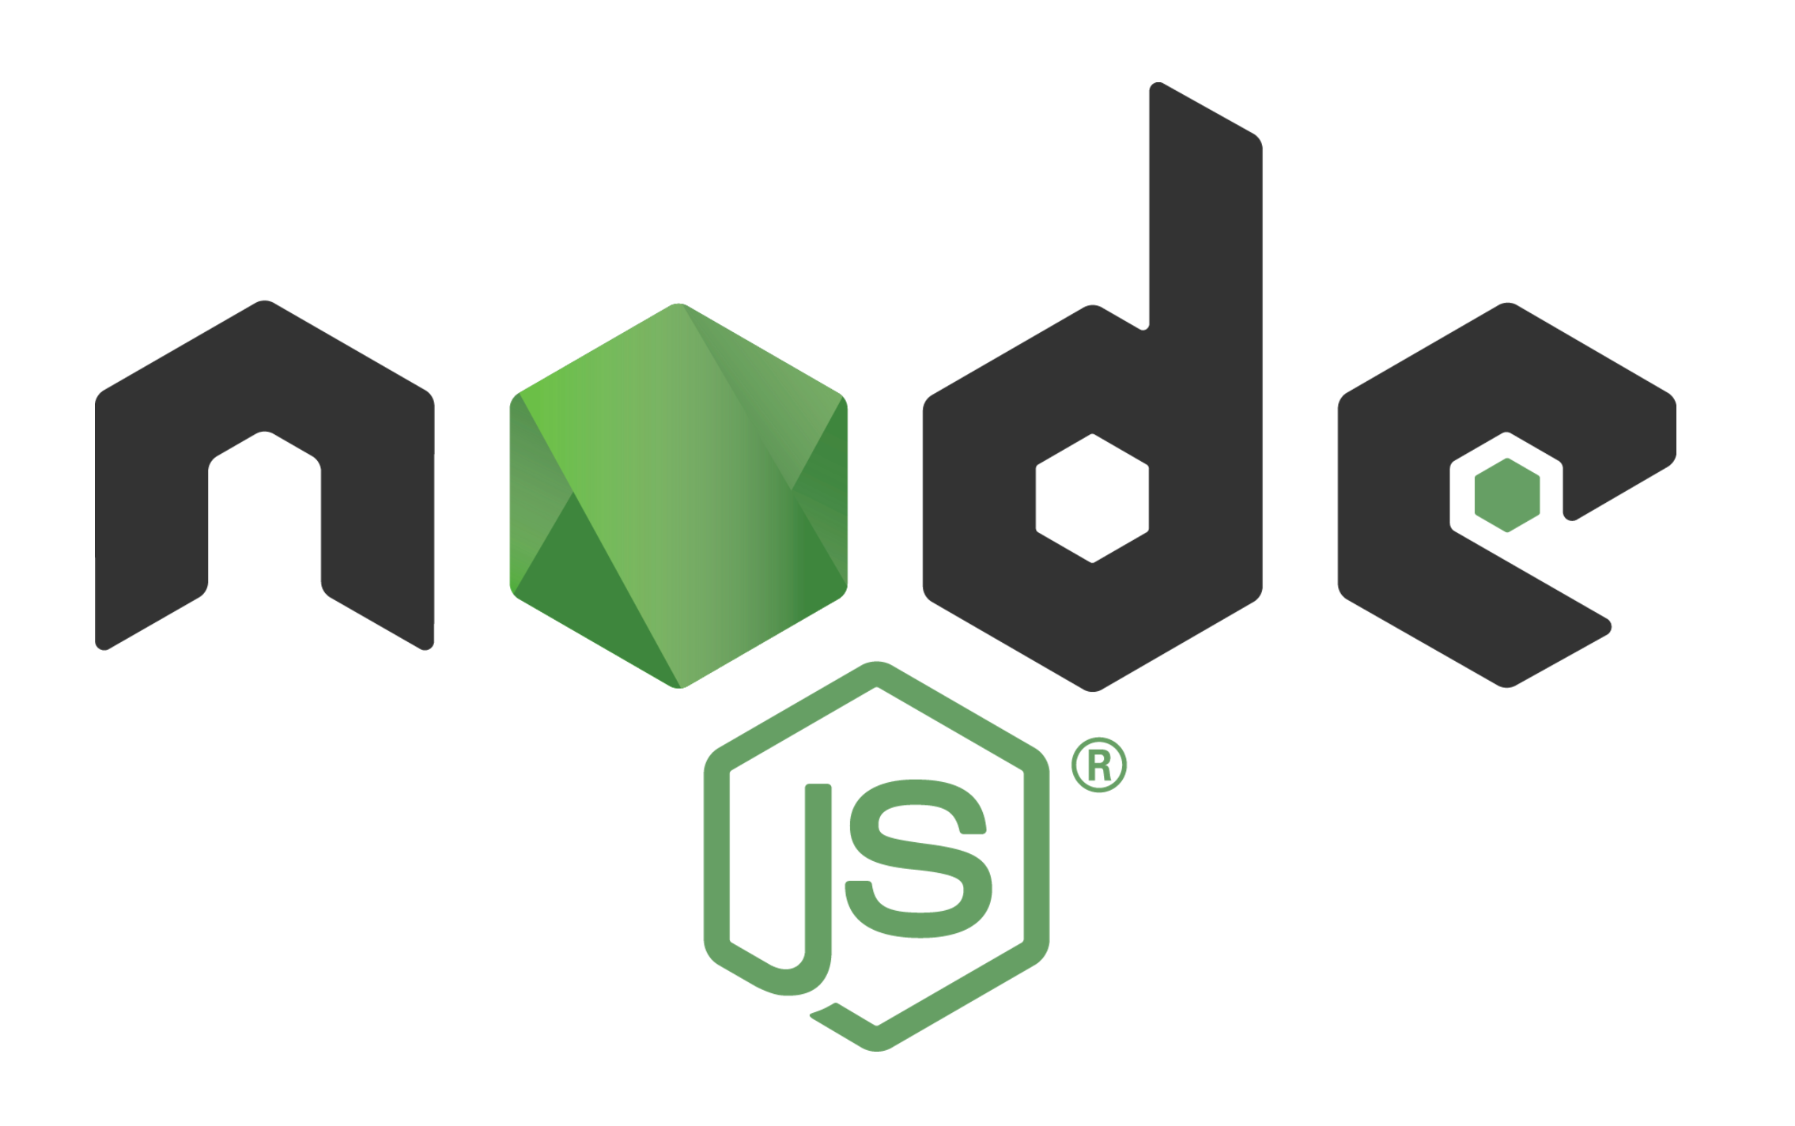
By,
Deepthi R

Slide 2
INTRODUCRION
In simple words Node.js is ‘server-side JavaScript’.
In not-so-simple words Node.js is a high- performance network applications framework, well optimized for high concurrent environments.
Node.js runs on V8 engine.
V8 is an open source JavaScript engine developed by Google. Its written in C++ and is used in Google Chrome Browser.
It was created by Ryan Dahl in 2009.
Is still in Beta phase.

Slide 3
It’s a command line tool.
In ‘Node.js’ , ‘.js’ doesn’t mean that its only written JavaScript. It is 40% JS and 60% C++.
Latest version is 12.13.0.
Is Open Source and runs well on Linux systems, can also run on Windows systems
Node.js is released under the MIT license
‘Nodes goal is to provide an easy way to build scalable network programs’ .

Slide 4
Node.js is a platform built on Chrome's JavaScript runtime for easily building fast and scalable network applications.
Node.js uses an event-driven, non-blocking I/O model that makes it lightweight and efficient, perfect for data-intensive real-time applications that run across distributed devices.
There is no DOM implementation provided by Node.js, i.e. you can not do this:
var element = document.getElementById(‘elementId‛);
Everything inside Node.js runs in a single-thread.
Notes:
DOM = Document Object Model

Slide 5
What Can Node.js Do?
Node.js can generate dynamic page content.
Node.js can create, open, read, write, delete, and close files on the server.
Node.js can collect form data.
Node.js can add, delete, modify data in your database.
You can create a DNS ,Static File Server ,Web Chat Application like GTalk in the browser.
Node.js can also be used for creating online games, collaboration tools or anything which sends updates to the user in real-time

Slide 6
Thank you

